Slide 1

Javascript HTML DOM
With the html dom, javascript can access and change all the elements of an html document.
The HTML DOM (Document Object Model) :- When a web page is loaded, the browser creates a document object model of the page. the html dom model is constructed as a tree of objects: The HTML DOM Tree of Objects
With the object model, JavaScript gets all the power it needs to create dynamic HTML:
JavaScript can change all the HTML elements in the page
JavaScript can change all the HTML attributes in the page
JavaScript can change all the CSS styles in the page
JavaScript can remove existing HTML elements and attributes
JavaScript can add new HTML elements and attributes
JavaScript can react to all existing HTML events in the page
JavaScript can create new HTML events in the page

Slide 2
What is the HTML DOM?
The HTML DOM is a standard object model and programming interface for HTML. It defines:
The HTML elements as objects
The properties of all HTML elements
The methods to access all HTML elements
The events for all HTML elements
In other words: The HTML DOM is a standard for how to get, change, add, or delete HTML elements.
2. The DOM Programming Interface
The HTML DOM can be accessed with JavaScript (and with other programming languages).
In the DOM, all HTML elements are defined as objects.
The programming interface is the properties and methods of each object.
A property is a value that you can get or set (like changing the content of an HTML element).
A method is an action you can do (like add or deleting an HTML element).

Slide 3
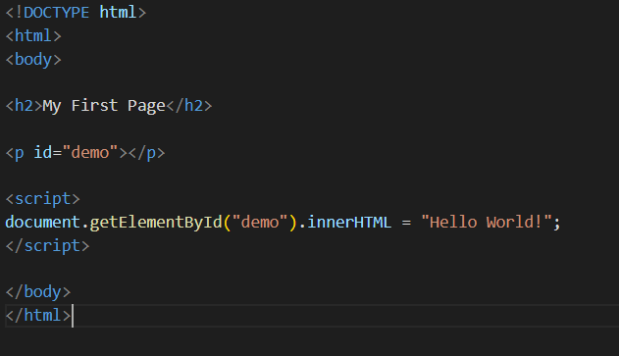

Example:-
The following example changes the content (the innerHTML) of the <p> element with id="demo“:

Slide 4
3. The getElementById Method :-
The most common way to access an HTML element is to use the id of the element.
The getElementById method uses id="demo" to find the element.
4. The inner HTML Property :-
The easiest way to get the content of an element is by using the innerHTML property.
The innerHTML property is useful for getting or replacing the content of HTML elements.

Slide 5
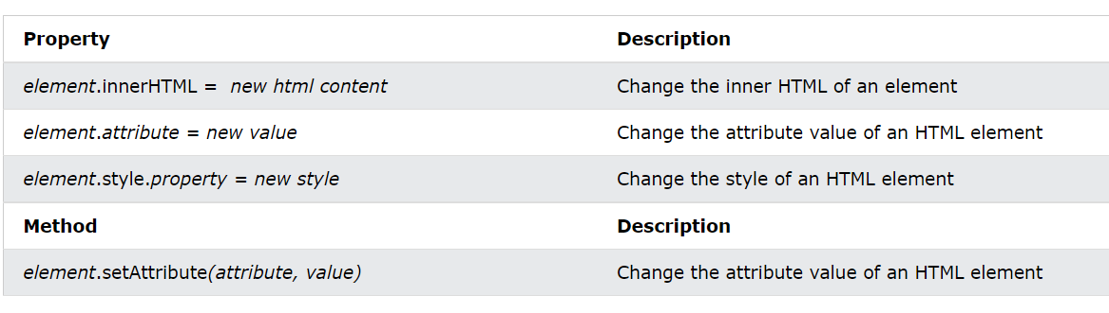
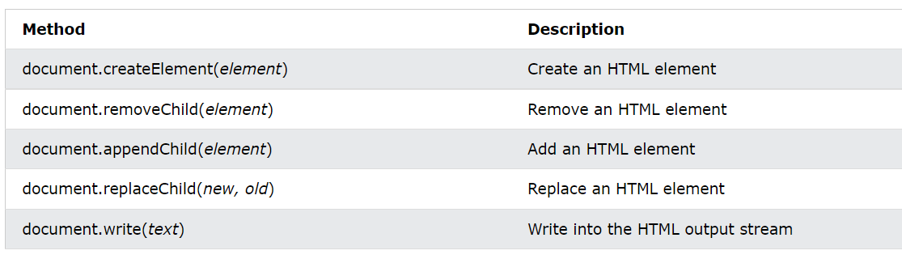
6. Changing HTML Elements :-
7. Adding and Deleting Elements :-

Slide 6
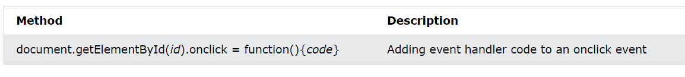
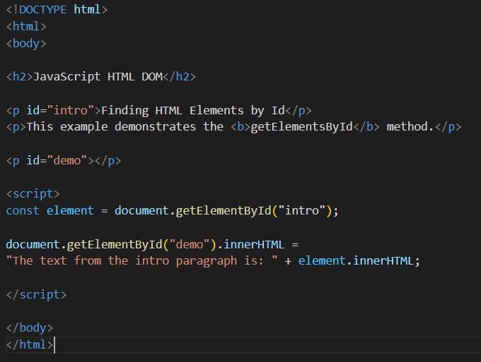
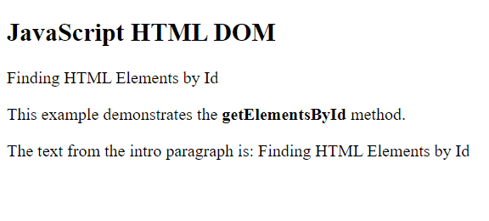
8. Adding Events Handlers :-
9. Finding HTML Elements :-
Often, with JavaScript, you want to manipulate HTML elements.To do so, you have to find the elements first. There are several ways to do this:
1. Finding HTML Element by Id :- The easiest way to find an HTML element in the DOM, is by using the element id. This example finds the element with id="intro":

Slide 7
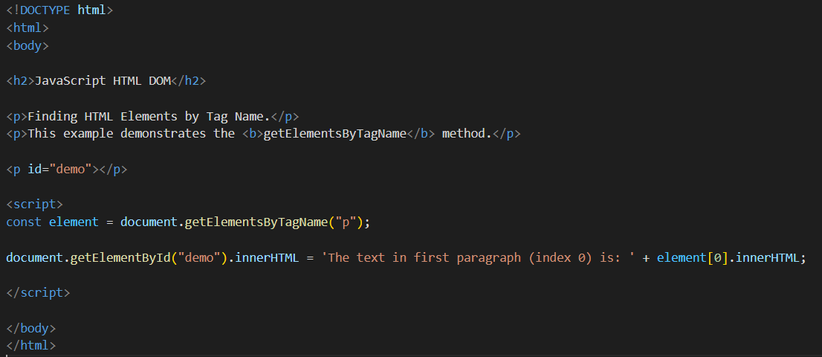
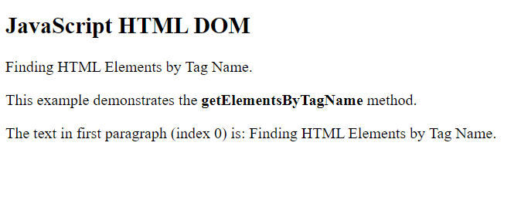
2. Finding HTML Elements by Tag Name :-
This example finds all <p> elements:

Slide 8
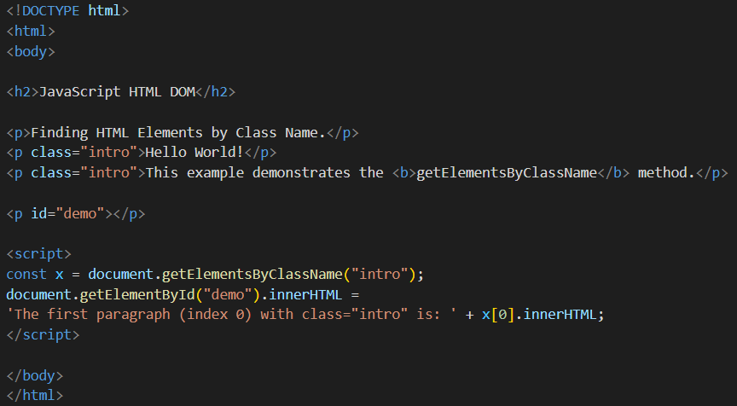
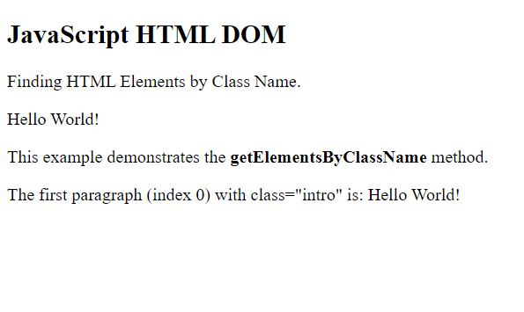
3. Finding HTML Elements by Class Name :-
If you want to find all HTML elements with the same class name, use getElementsByClassName(). This example returns a list of all elements with class="intro".

Slide 9
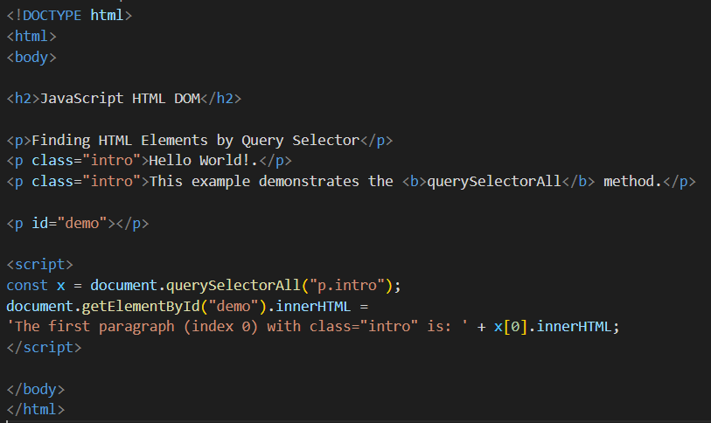
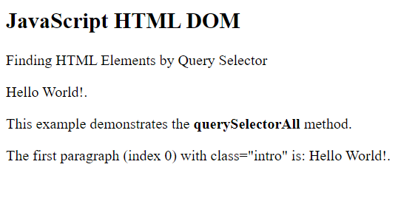
4. Finding HTML Elements by CSS Selectors :-
If you want to find all HTML elements that match a specified CSS selector (id, class names, types, attributes, values of attributes, etc), use the querySelectorAll() method.
This example returns a list of all <p> elements with class="intro".

Slide 10
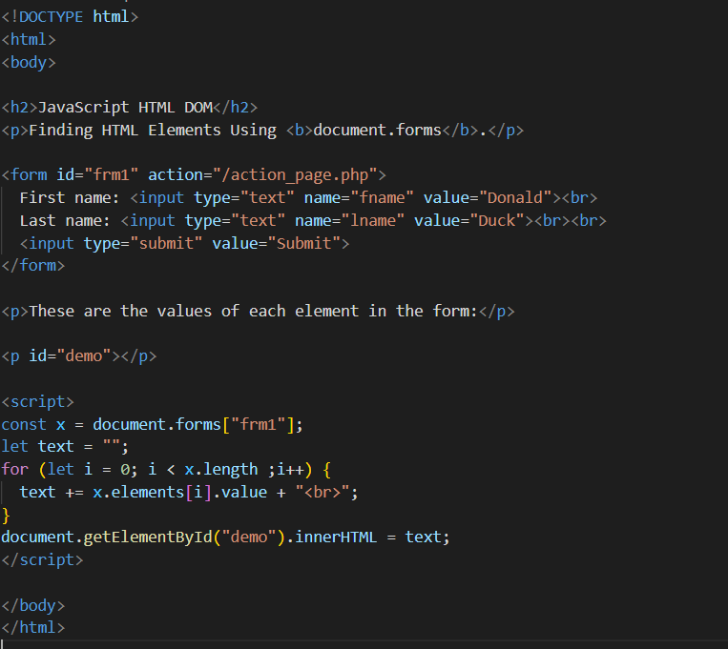
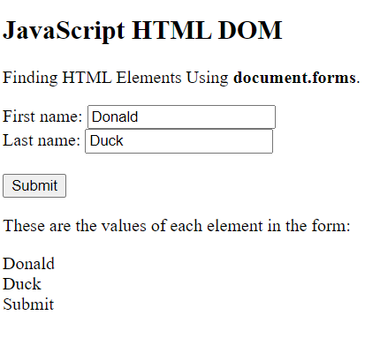
5. Finding HTML Elements by HTML Object Collections :-
This example finds the form element with id="frm1", in the forms collection, and displays all element values:

Slide 11
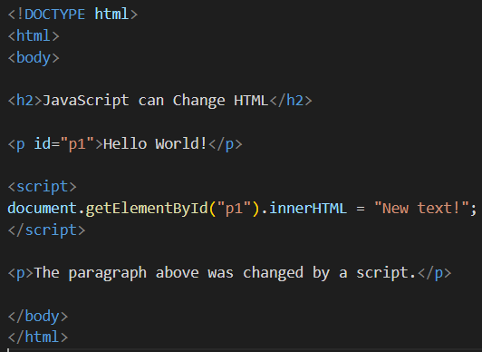
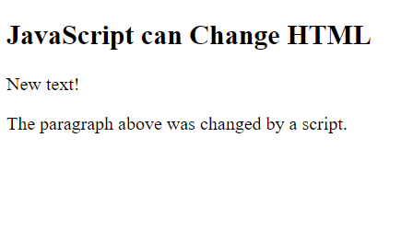
10. Changing HTML Content :-
The easiest way to modify the content of an HTML element is by using the innerHTML property.
To change the content of an HTML element, use this syntax:
document.getElementById(id).innerHTML = new HTML
This example changes the content of a <p> element:
Example explained:
The HTML document above contains a <p> element with id="p1“.
We use the HTML DOM to get the element with id="p1“.
A JavaScript changes the content (innerHTML) of that element to "New text!“.

Slide 12
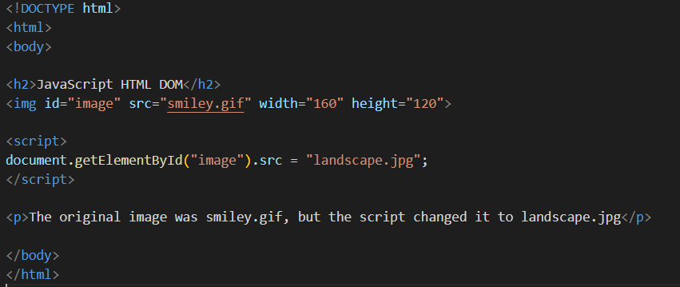
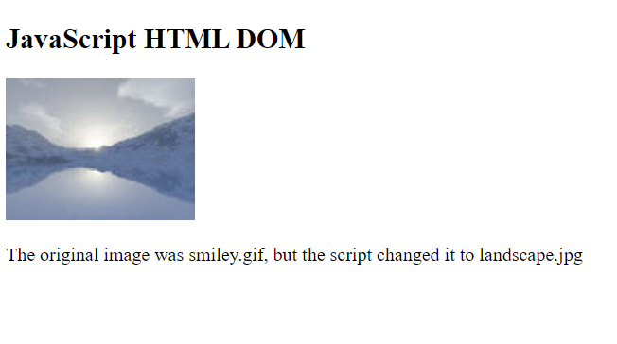
11. Changing the Value of an Attribute :-
To change the value of an HTML attribute, use this syntax:
document.getElementById(id).attribute = new value
This example changes the value of the src attribute of an <img> element:
Example explained:
The HTML document above contains an <img> element with id="myImage"
We use the HTML DOM to get the element with id="myImage"
A JavaScript changes the src attribute of that element from "smiley.gif" to "landscape.jpg"

Slide 13
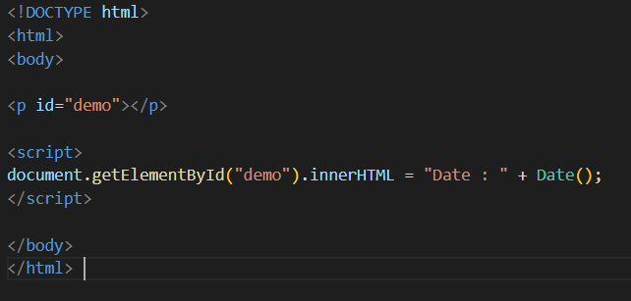

12. Dynamic HTML content :-
JavaScript can create dynamic HTML content:

Slide 14
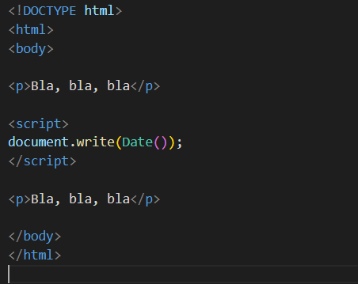
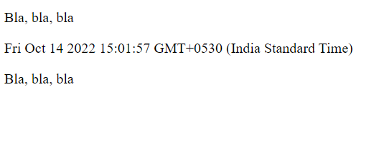
13. document.write() :-
In JavaScript, document.write() can be used to write directly to the HTML output stream:

Slide 15
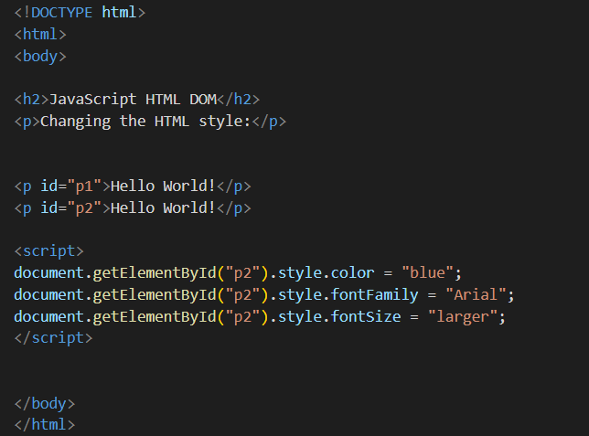
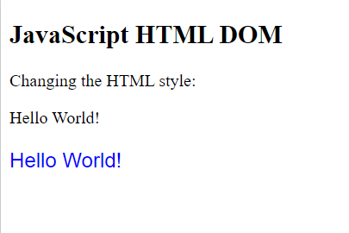
14. Changing HTML Style :-
To change the style of an HTML element, use this syntax:
document.getElementById(id).style.property = new style
The following example changes the style of a <p> element:

Slide 16
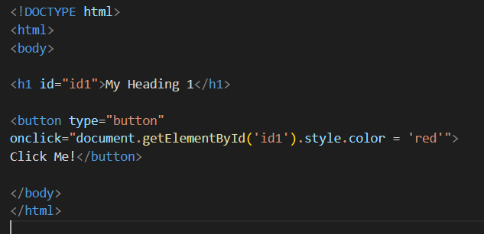
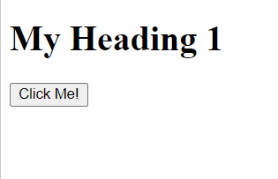
15. Using Events :-
The HTML DOM allows you to execute code when an event occurs.
Events are generated by the browser when "things happen" to HTML elements:
An element is clicked on
The page has loaded
Input fields are changed
You will learn more about events in the next chapter of this tutorial.
This example changes the style of the HTML element with id="id1", when the user clicks a button:

Slide 17
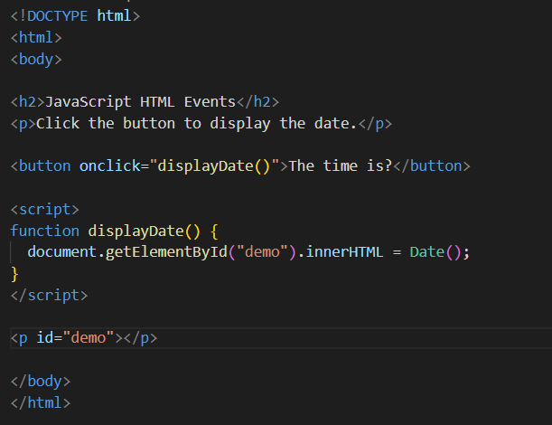
16. HTML Event Attributes :-
To assign events to HTML elements you can use event attributes.
In the example above, a function named displayDate will be executed when the button is clicked.
Write the following code in your VS code and see the result.

Slide 18
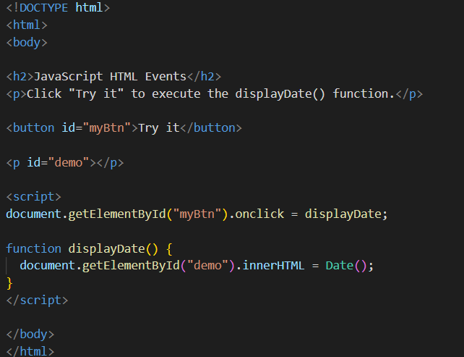
17. Assign Events Using the HTML DOM :-
The HTML DOM allows you to assign events to HTML elements using JavaScript:
In the example above, a function named displayDate is assigned to an HTML element with the id="myBtn".
The function will be executed when the button is clicked.
Write the following code in your VS code and see the result.

Slide 19
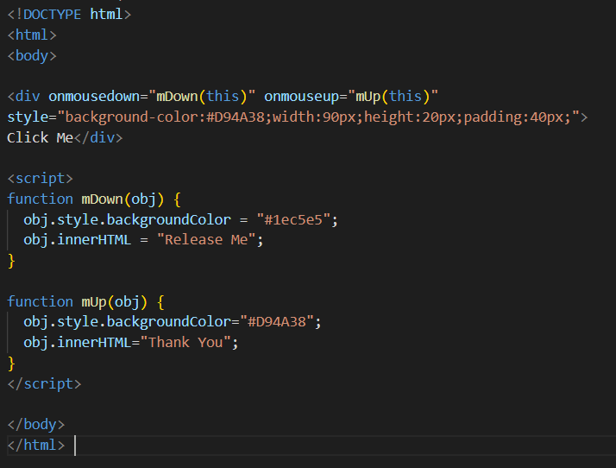
18. The onmousedown, onmouseup and onclick Events :-
The onmousedown, onmouseup, and onclick events are all parts of a mouse-click. First when a mouse-button is clicked, the onmousedown event is triggered, then, when the mouse-button is released, the onmouseup event is triggered, finally, when the mouse-click is completed, the onclick event is triggered.
Write the following code in your VS code and see the result.

Slide 20
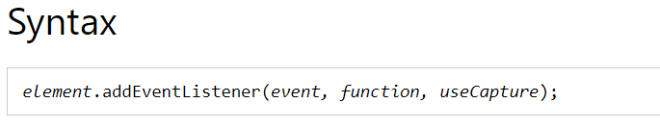
19. The addEventListener() method :-
The addEventListener() method attaches an event handler to the specified element.
The addEventListener() method attaches an event handler to an element without overwriting existing event handlers.
You can add many event handlers to one element.
You can add many event handlers of the same type to one element, i.e two "click" events.
You can add event listeners to any DOM object not only HTML elements. i.e the window object.
The addEventListener() method makes it easier to control how the event reacts to bubbling.
When using the addEventListener() method, the JavaScript is separated from the HTML markup, for better readability and allows you to add event listeners even when you do not control the HTML markup.
You can easily remove an event listener by using the removeEventListener() method.
The first parameter is the type of the event (like "click" or "mousedown" or any other HTML DOM Event.)
The second parameter is the function we want to call when the event occurs.
The third parameter is a boolean value specifying whether to use event bubbling or event capturing. This parameter is optional.

Slide 21
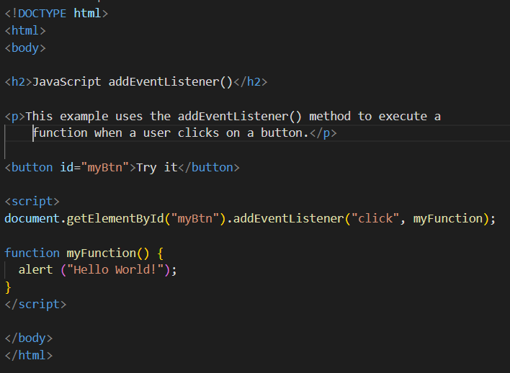
Write the following code in your VS code and see the result.

Slide 22
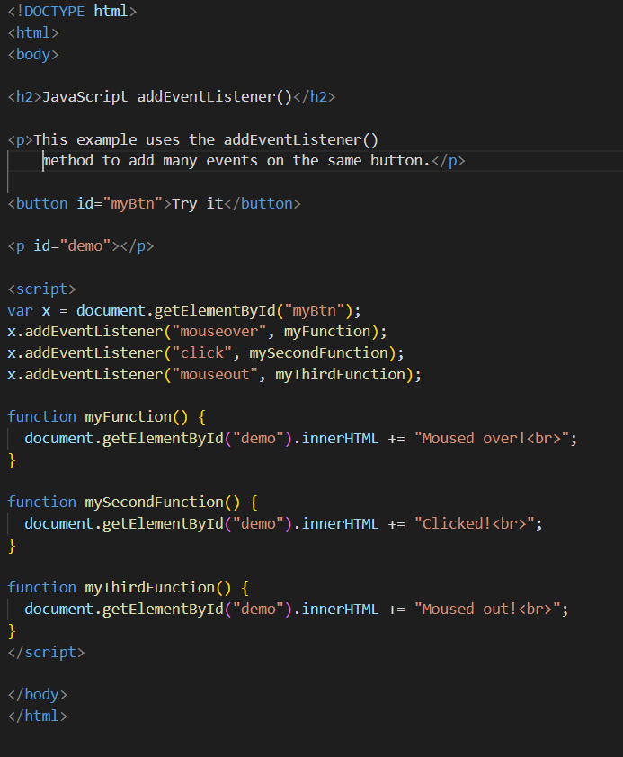
20. Add Many Event Handlers to the Same Element :-
The addEventListener() method allows you to add many events to the same element, without overwriting existing events:
Write the following code in your VS code and see the result.

Slide 23
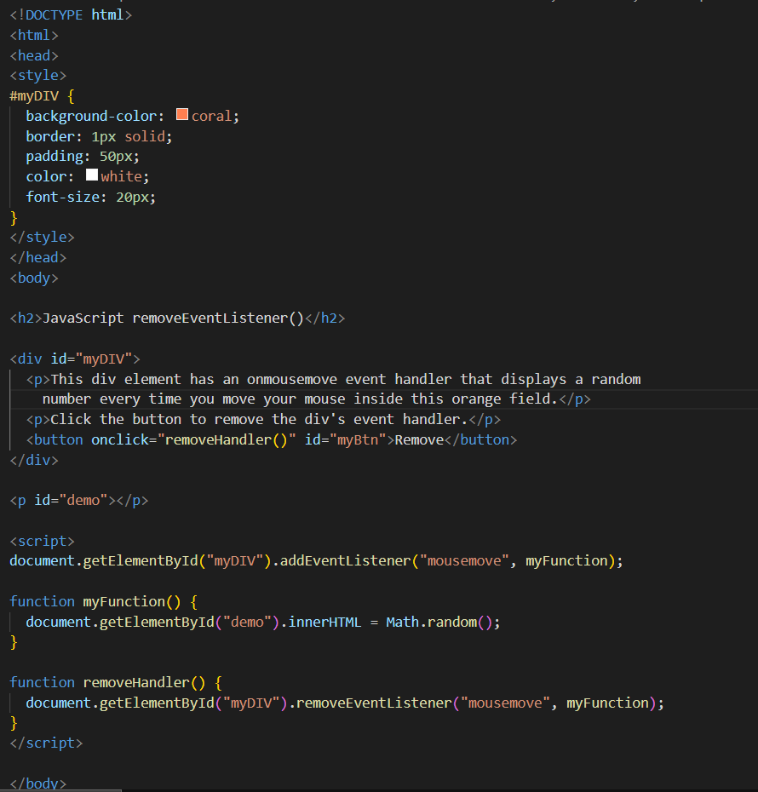
21. The removeEventListener() method :-
The removeEventListener() method removes event handlers that have been attached with the addEventListener() method:
Write the following code in
your VS code and
see the result.

